Slide 1



R Studio
S.Mohan Kumar

Slide 2
What is R?
a programming “environment”
object-oriented
Open Source
provides calculations on matrices
excellent graphics capabilities
supported by a large community

Slide 3
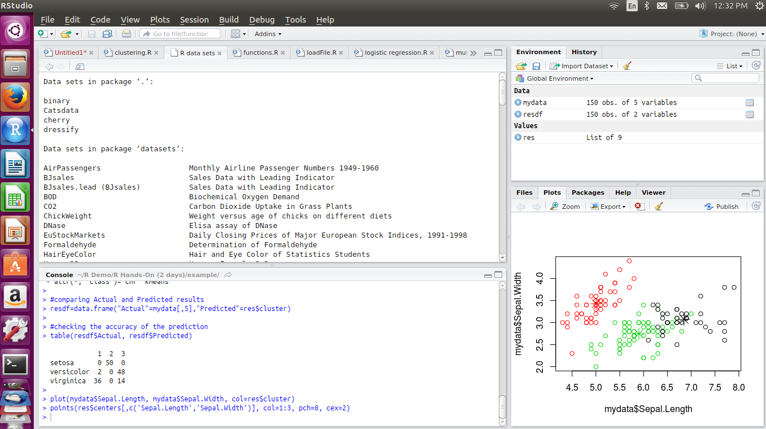
R-Studio Demo
Copyright Trendwise Analytics

Slide 4
Workspace
during an R session, all objects are stored in a temporary, working memory
list objects
ls()
remove objects
rm()
objects that you want to access later must be saved in a “workspace”
from the menu bar: File->save workspace
from the command line: save(x,file=“MyData.Rdata”)

Slide 5
History
command line history
can be saved, loaded, or displayed
savehistory(file=“MyData.Rhistory)
loadhistory(file=“MyData.Rhistory)
history(max.show=Inf)
during a session you can use the arrow keys to review the command history

Slide 6
R-Stdio environment
Understanding the environment
Opening and saving workspace
Removing objects from memory
Using the Keyboard
Incomplete commands
Help
Packages
Copyright Trendwise Analytics

Slide 7
Naming Convention
must start with a letter (A-Z or a-z)
can contain letters, digits (0-9), and/or periods “.”
case-sensitive
mydata different from MyData
do not use underscore “_”

Slide 8
Assignment
“<-” used to indicate assignment
x<-c(1,2,3,4,5,6,7)
x<-c(1:7)
X<-1:4
Now “=” is also a valid assignment

Slide 9
Functions or commands in R 2/3
R is case sensitive, so take care when typing in the commands!
  library(affy) works, but Library(affy) does not.
Multiple commands can be written on the same line. Here we first remove missing values from the variable year, and then calculate it’s arithmetic average.
  Writing:
    na.omit(year)
    mean(year)
  Would be the same as
    mean(na.omit(year))

Slide 10
R- Studio hands on
1. Start R Studio.
2. Type 3+4 directly in the Console
3. Use the Editor to type and run the following:
  100/5 – 10
  4^2
  sqrt(100)
4. Save this as an R script and close R Studio
5. Open R Studio and load the previously stored R script.

Slide 11
Programming in R
Comments - ###
Assignment : ← or =
X← 3 or X=3
Built in Mathematical functions
  Simple addition, subtraction, multiplication,division,squares,cubes,square roots etc.

Slide 12
Programming in R
Vectors and vector operations
x=c(2,3,4,5,6)
x+2,x*2,x/2
Sequence
1:10
Seq(5,100,5)

Slide 13
Hands-on
1. Calculate the BMI for four people whose weights and heights are available as follows
Wights: 75,80,65,85 in kg
Heights: 180,165,190,170 in cm
BMI = weight in kg/(height in m)^2

Slide 14
Programming in R
Simple summary statistics (summarystats.r)
Sum, length,mean,median,summary
Hands-on:
1. Temperature of four individuals is available in centigrade scale as follows:
19,23,27,20
Store this in a vector. Create another vector to store the values in Fahrenheit scale.
f=c*9/5 +32

Slide 15
Programming in R
Hands-on:
2. We need to calculate the volume of the cones with following dimensions:
Radius= 2,4,6,8
Height = 10,12,14,16
Calculate the volumes and store as a vector. Display the volumes and the basic statistics: mean, median and sd.

